Slide 1
Mobile Application Development - Day 11
AutoComplete
Menu
ButterKnife

Slide 2
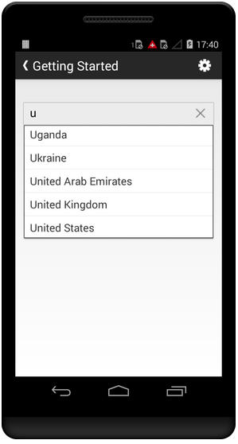
AutoComplete
An editable text view that shows completion suggestions automatically while the user is typing.
Suggestions are shown in drop down
Users can choose an item from drop down
The drop down can be dismissed at any time by pressing the back key
The list of suggestions is obtained from a data adapter and appears only after a given number of characters defined by the threshold.

Slide 3
AutoComplete - Code Snippet
public class CountriesActivity extends Activity {
protected void onCreate(Bundle icicle) {
super.onCreate(icicle);
setContentView(R.layout.countries);
ArrayAdapter<String> adapter = new ArrayAdapter<String>(this,layout_name, COUNTRIES);
AutoCompleteTextView textView = AutoCompleteTextView)findViewById(R.id.countries_list);
textView.setAdapter(adapter);
}
private static final String[] COUNTRIES = {"Belgium", "France", "Italy", "Germany", "Spain"};
}

Slide 4
AutoComplete
<AutoCompleteTextView android:id="@+id/autoCompleteTextView" android:layout_width="wrap_content" android:layout_height="wrap_content" />

Slide 5
Menu
for all menu types, Android provides a standard XML format to define menu items
define a menu and all its items in an XML menu resource
inflate the menu resource (load it as a Menu object) in your activity or fragment.
types of menus
Options Menu
Context Menu
Popup Menu

Slide 6
Menu - Defining Menu in XML
create an XML file inside your project's res/menu/ directory
<menu>
Defines a Menu, which is a container for menu items. A <menu> element must be the root node for the file and can hold one or more <item> and <group> elements.
<item>
Creates a MenuItem, which represents a single item in a menu. This element may contain a nested <menu>element in order to create a submenu.
<group>
An optional, invisible container for <item> elements. It allows you to categorize menu items so they share properties such as active state and visibility.

Slide 7
Menu
<menu>
<item> </item>
<item> </item>
</menu>

Slide 8
Menu - XML
<?xml version="1.0" encoding="utf-8"?>
<menu xmlns:android="http://schemas.android.com/apk/res/android">
<item android:id="@+id/new_game"
android:icon="@drawable/ic_new_game"
android:title="@string/new_game"
android:showAsAction="ifRoom"/>
<item android:id="@+id/help"
android:icon="@drawable/ic_help"
android:title="@string/help" />
</menu>

Slide 9
Menu - <item>
The <item> element supports several attributes you can use to define an item's appearance and behavior. The items in the above menu include the following attributes:
Android:id A resource ID that's unique to the item, which allows the application to recognize the item when the user selects it.
Android:icon A reference to a drawable to use as the item's icon.
Android:title A reference to a string to use as the item's title.
android:showAsAction Specifies when and how this item should appear as an action item in the app bar.

Slide 10
Menu - Nested Item
<?xml version="1.0" encoding="utf-8"?>
<menu xmlns:android="http://schemas.android.com/apk/res/android">
<item android:id="@+id/file"
android:title="@string/file" >
<!-- "file" submenu -->
<menu>
<item android:id="@+id/create_new"
android:title="@string/create_new" />
<item android:id="@+id/open"
android:title="@string/open" />
</menu>
</item>
</menu>

Slide 11
Menu - group item
<?xml version="1.0" encoding="utf-8"?>
<menu xmlns:android="http://schemas.android.com/apk/res/android">
<item android:id="@+id/menu_save"
android:icon="@drawable/menu_save"
android:title="@string/menu_save" />
<!-- menu group -->
<group android:id="@+id/group_delete">
<item android:id="@+id/menu_archive"
android:title="@string/menu_archive" />
<item android:id="@+id/menu_delete"
android:title="@string/menu_delete" />
</group>
</menu>

Slide 12
ButterKnife
Eliminate findViewById calls by using @BindView on fields.
Eliminate anonymous inner-classes for listeners by annotating methods with @OnClick and others.

Slide 13
ButterKnife
android {
compileOptions {
sourceCompatibility JavaVersion.VERSION_1_8
targetCompatibility JavaVersion.VERSION_1_8
}
}

Slide 14
ButterKnife
dependencies {
implementation 'com.jakewharton:butterknife:10.2.1'
annotationProcessor 'com.jakewharton:butterknife-compiler:10.2.1'
}

Slide 15
ButterKnife - Binding View
class ExampleActivity extends Activity {
@BindView(R.id.user) EditText username;
@BindView(R.id.pass) EditText password;
}

Slide 16
ButterKnife - Binding View
@Override public void onCreate(Bundle savedInstanceState) {
@BindView(R.id.user) EditText username;
super.onCreate(savedInstanceState);
setContentView(R.layout.simple_activity);
ButterKnife.bind(this);
}

Slide 17
ButterKnife - OnClick
@OnClick(R.id.submit) void submit() {
// TODO call server...
}

